Slide 1
Stack ADT and Its Applications

Slide 2
Simple Array Implementation of Lists
Disadvantages:
An estimate of the maximum size of the list is required, even if the array is dynamically allocated. Usually this requires a high overestimate, which wastes considerable space.
Insertion and deletion are expensive. For example, inserting at position 0 requires first pushing the entire array down one spot to make room.
Because the running time for insertions and deletions is so slow and the list size must be known in advance, simple arrays are generally not used to implement lists.

Slide 3

Motivation
How is undo and redo functionality typically implemented?
Suppose you perform following in word application
First you typed a word
Secondly, you bold it
Thirdly, You underlined it
Fourth, you changed its color?
Fifth you change its font size?
In which order action will redo?
The action that we performed in last will redo first
Last In First Out

Slide 4
Examples
Example 1: Text editors usually provide an “undo” mechanism that cancels recent editing operations and reverts to former states of a document. This undo operation can be accomplished by keeping text changes in a stack.
Example 2: Internet Web browsers store the addresses of recently visited sites in a stack. Each time a user visits a new site, that site’s address is “pushed” onto the stack of addresses. The browser then allows the user to “pop” back to previously visited sites using the “back” button.

Slide 5
Stack ADT
A stack is a list with the restriction that insertions and deletions can be performed in only one position, namely, the end of the list, called the top.
The fundamental operations on a stack are Push, which is equivalent to an insert, and Pop, which deletes the most recently inserted element.
The most recently inserted element can be examined prior to performing a Pop by use of the Top routine.

Slide 6
Stack ADT
A Pop or Top on an empty stack is generally considered an error (stack underflow error) in the stack ADT.
Running out of space when performing a Push is an implementation error (stack overflow error) but not an ADT error.
Stacks are sometimes known as LIFO (last in, first out) lists.

Slide 7
Stack ADT
Top
7
9
4
2
3
6
Stack model: only the top element is accessible

Slide 8
Implementation of Stacks
Since a stack is a list, any list implementation will do.
We will give two popular implementations. One uses pointers and the other uses an array.
No matter in which case, if we use good programming principles, the calling routines do not need to know which method is being used.

Slide 9
Array Implementation of Stacks
A Stack is defined as a pointer to a structure. The structure contains the TopOfStack and Capacity fields. Once the maximum size is known, the stack array can be dynamically allocated.
Associated with each stack is TopOfStack, which is -1 for an empty stack (this is how an empty stack is initialized).

Slide 10
Array Implementation of Stacks
To push some element X onto the stack, we increment TopOfStack and then set Stack[TopOfStack]=X, where Stack is the array representing the actual stack.
To pop, we set the return value to Stack[TopOfStack] and then decrement TopOfStack.

Slide 11
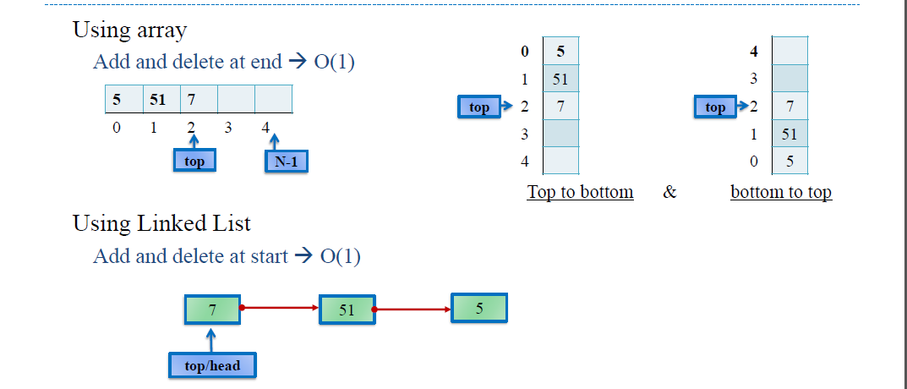

Slide 12
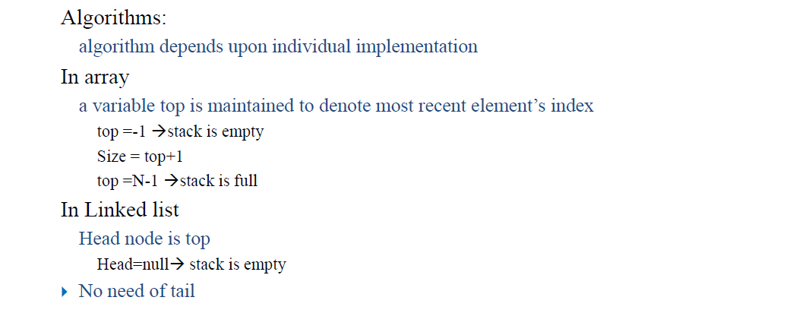
Implementation

Slide 13
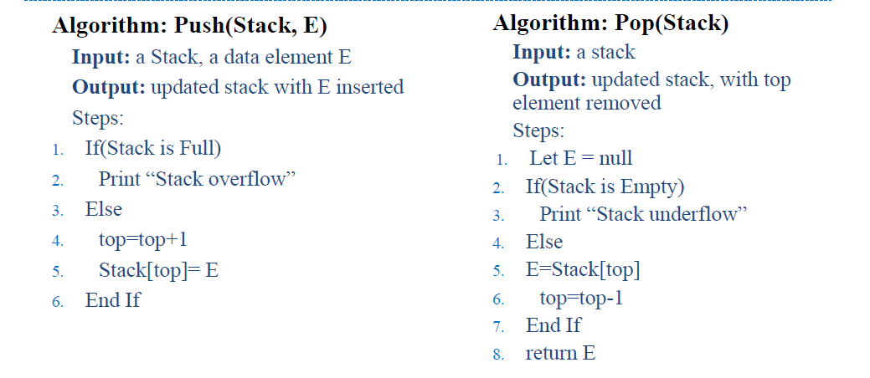
Algorithm (Array based)

Slide 14
Array Implementation of Stacks

Slide 15
Array Implementation of Stacks

Slide 16
Application of Stacks
Methods calls within a program; functions are called in order and data is stored
in activation stack
Back button on browser store page history
Undo/redo in editors
Used by compilers to check program syntax
Arithmetic Expression Evaluation
To reverse contents of something like string, array
Decimal to binary conversion

Slide 17
Infix Notation
To add A, B, we write
A+B
To multiply A, B, we write
A*B
The operators ('+' and '*') go in between the operands ('A' and 'B')
This is "Infix" notation.

Slide 18
Prefix Notation
Instead of saying "A plus B", we could say "add A,B " and write
+ A B
"Multiply A,B" would be written
* A B
This is Prefix notation.

Slide 19
Postfix Notation
Another alternative is to put the operators after the operands as in
A B +
and
A B *
This is Postfix notation.
Notes:
"A,B are multiplied"
"A,B are added"

Slide 20
Infix, Prefix and Postfix
The terms infix, prefix, and postfix tell us whether the operators go between, before, or after the operands.

Slide 21
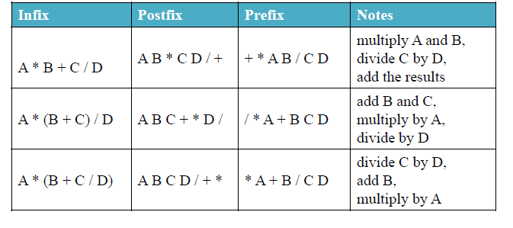
Arithmetic Expression Evaluation

Slide 22
Reverse-Polish Notation
Normally, mathematics is written using what we call in-fix notation:
(3 + 4) × 5 – 6
The operator is placed between to operands
One weakness: parentheses are required
(3 + 4) × 5 – 6 = 29
3 + 4 × 5 – 6 = 17
3 + 4 × (5 – 6) = –1
(3 + 4) × (5 – 6) = –7

Slide 23
Parentheses
Evaluate 2+3*5.
+ First:
(2+3)*5 = 5*5 = 25
* First:
2+(3*5) = 2+15 = 17
Infix notation requires Parentheses.

Slide 24
What about Prefix Notation?
+ 2 * 3 5 =
= + 2 * 3 5
= + 2 15 = 17
* + 2 3 5 =
= * + 2 3 5
= * 5 5 = 25
No parentheses needed!

Slide 25
Postfix Notation
2 3 5 * + =
= 2 3 5 * +
= 2 15 + = 17
2 3 + 5 * =
= 2 3 + 5 *
= 5 5 * = 25
No parentheses needed here either!

Slide 26
Conclusion:
Infix is the only notation that requires parentheses in order to change the order in which the operations are done.

Slide 27
Fully Parenthesized Expression
A FPE has exactly one set of Parentheses enclosing each operator and its operands.
Which is fully parenthesized?
( A + B ) * C
( ( A + B) * C )
( ( A + B) * ( C ) )

Slide 28
Reverse-Polish Notation
When we place the operands first, followed by the operator:
(3 + 4) × 5 – 6
3 4 + 5 × 6 –
Parsing reads left-to-right and performs any operation on the last two operands:
3 4 + 5 × 6 –
7 5 × 6 –
35 6 –
29

Slide 29
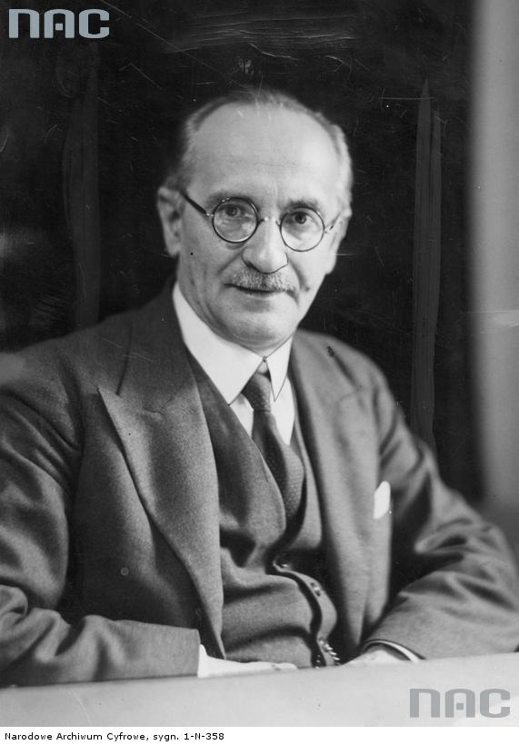
Reverse-Polish Notation
This is called reverse-Polish notation after the mathematician Jan Łukasiewicz
this forms the basis of the recursive stack used on all processors
He also made significant contributions to logic and other fields
http://www.audiovis.nac.gov.pl/
http://xkcd.com/645/

Slide 30
Reverse-Polish Notation
Benefits:
No ambiguity and no brackets are required
It is the same process used by a computer to perform computations:
operands must be loaded into registers before operations can be performed on them
Reverse-Polish can be processed using stacks

Slide 31
Infix to Prefix Conversion
Move each operator to the left of its operands & remove the parentheses:
( ( A + B) * ( C + D ) )
Notes:
Start with Fully parenthesized expression. Move each operator to the left of its operands and remove the set of parentheses.

Slide 32
Infix to Prefix Conversion
Move each operator to the left of its operands & remove the parentheses:
( + A B * ( C + D ) )
Notes:
Start with Fully parenthesized expression. Move each operator to the left of its operands and remove the set of parentheses.

Slide 33
Infix to Prefix Conversion
Move each operator to the left of its operands & remove the parentheses:
* + A B ( C + D )
Notes:
Start with Fully parenthesized expression. Move each operator to the left of its operands and remove the set of parentheses.

Slide 34
Infix to Prefix Conversion
Move each operator to the left of its operands & remove the parentheses:
* + A B + C D
Order of operands does not change!
Notes:
Start with Fully parenthesized expression. Move each operator to the left of its operands and remove the set of parentheses.

Slide 35
Infix to Postfix
( ( ( A + B ) * C ) - ( ( D + E ) / F ) )
A B + C * D E + F / -
Operand order does not change!
Operators are in order of evaluation!

Slide 36
Computer Algorithm FPE Infix To Postfix
Assumptions:
Space delimited list of tokens represents a FPE infix expression
Operands are single characters.
Operators +,-,*,/

Slide 37
FPE Infix To Postfix
Initialize a Stack for operators, output list
Split the input into a list of tokens.
for each token (left to right):
if it is operand: append to output
if it is '(': push onto Stack
if it is ')': pop & append till '('

Slide 38
Infix to Postfix
Initialize a Stack for operators, output list
Split the input into a list of tokens.
for each token (left to right):
if it is operand: append to output
if it is '(': push onto Stack
if it is ')': pop & append till '('
if it is '+-*/':
while peek has precedence ≥ it:
pop & append
push onto Stack
pop and append the rest of the Stack.

Slide 39
Create an empty stack for keeping operators. Create an empty list for output.
Split the input into a list of tokens.
Scan the token list from left to right.
If the token is an operand, append it to the end of the output list.
If the token is a left parenthesis, push it on the opstack.
If the token is a right parenthesis, pop the opstack until the corresponding left parenthesis is removed. Append each operator to the end of the output list.
If the token is an operator, *, /, +, or -, push it on the opstack. However, first remove any operators already on the opstack that have higher or equal precedence and append them to the output list.
When the input expression has been completely processed, check the opstack. Any operators still on the stack can be removed and appended to the end of the output list.

Slide 40
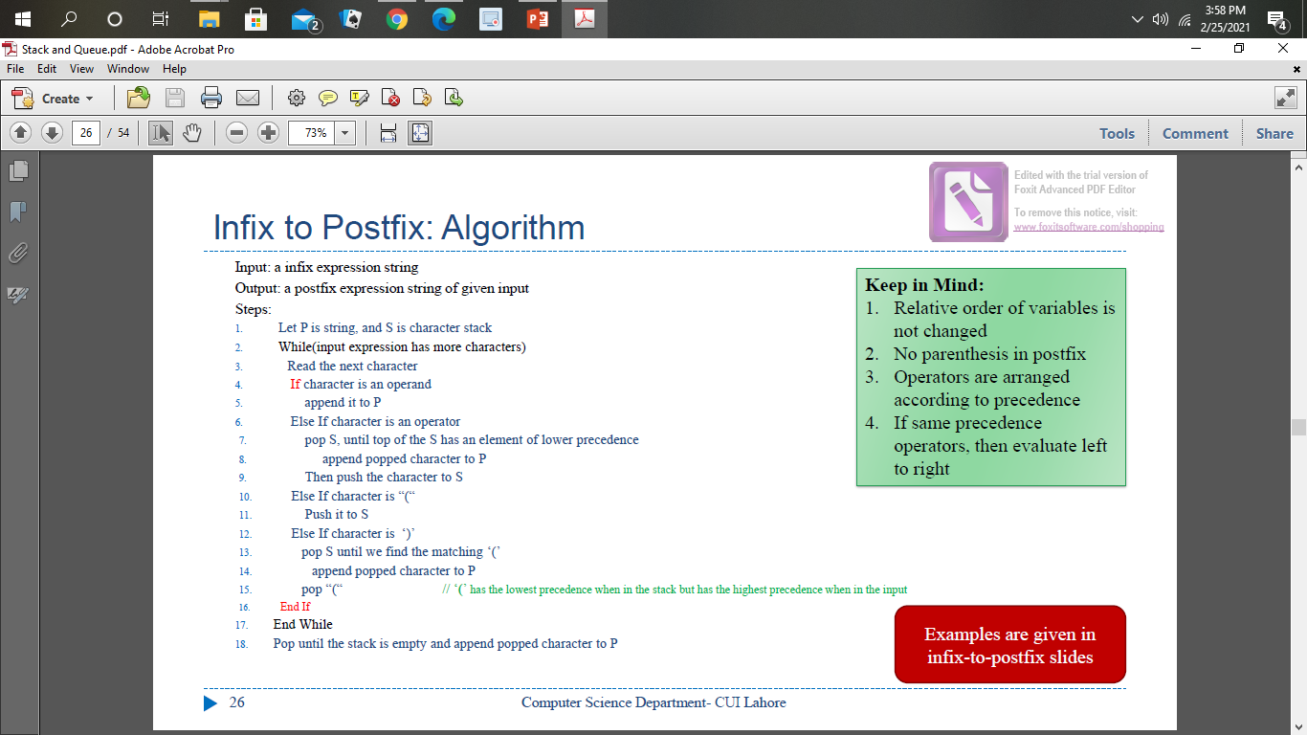
Infix to Postfix Algorithm

Slide 41
FPE Infix to Postfix
( ( ( A + B ) * ( C - E ) ) / ( F + G ) )
stack: <empty>
output: []

Slide 42
FPE Infix to Postfix
( ( A + B ) * ( C - E ) ) / ( F + G ) )
stack: (
output: []

Slide 43
FPE Infix to Postfix
( A + B ) * ( C - E ) ) / ( F + G ) )
stack: ( (
output: []

Slide 44
FPE Infix to Postfix
A + B ) * ( C - E ) ) / ( F + G ) )
stack: ( ( (
output: []

Slide 45
FPE Infix to Postfix
+ B ) * ( C - E ) ) / ( F + G ) )
stack: ( ( (
output: [A]

Slide 46
FPE Infix to Postfix
B ) * ( C - E ) ) / ( F + G ) )
stack: ( ( ( +
output: [A]

Slide 47
FPE Infix to Postfix
) * ( C - E ) ) / ( F + G ) )
stack: ( ( ( +
output: [A B]

Slide 48
FPE Infix to Postfix
* ( C - E ) ) / ( F + G ) )
stack: ( (
output: [A B + ]

Slide 49
FPE Infix to Postfix
( C - E ) ) / ( F + G ) )
stack: ( ( *
output: [A B + ]

Slide 50
FPE Infix to Postfix
C - E ) ) / ( F + G ) )
stack: ( ( * (
output: [A B + ]

Slide 51
FPE Infix to Postfix
- E ) ) / ( F + G ) )
stack: ( ( * (
output: [A B + C ]

Slide 52
FPE Infix to Postfix
E ) ) / ( F + G ) )
stack: ( ( * ( -
output: [A B + C ]

Slide 53
FPE Infix to Postfix
) ) / ( F + G ) )
stack: ( ( * ( -
output: [A B + C E ]

Slide 54
FPE Infix to Postfix
) / ( F + G ) )
stack: ( ( *
output: [A B + C E - ]

Slide 55
FPE Infix to Postfix
/ ( F + G ) )
stack: (
output: [A B + C E - * ]

Slide 56
FPE Infix to Postfix
( F + G ) )
stack: ( /
output: [A B + C E - * ]

Slide 57
FPE Infix to Postfix
F + G ) )
stack: ( / (
output: [A B + C E - * ]

Slide 58
FPE Infix to Postfix
+ G ) )
stack: ( / (
output: [A B + C E - * F ]

Slide 59
FPE Infix to Postfix
G ) )
stack: ( / ( +
output: [A B + C E - * F ]

Slide 60
FPE Infix to Postfix
) )
stack: ( / ( +
output: [A B + C E - * F G ]

Slide 61
FPE Infix to Postfix
)
stack: ( /
output: [A B + C E - * F G + ]

Slide 62
FPE Infix to Postfix
stack: <empty>
output: [A B + C E - * F G + / ]

Slide 63
Suppose we want to convert 2*3/(2-1)+5*3 into Postfix form,
Expression | Stack | Output
2 | Empty | 2
* | * | 2
3 | * | 23
/ | / | 23*
( | /( | 23*
2 | /( | 23*2
- | /(- | 23*2
1 | /(- | 23*21
) | / | 23*21-
+ | + | 23*21-/
5 | + | 23*21-/5
* | +* | 23*21-/53
3 | +* | 23*21-/53
 | Empty | 23*21-/53*+
So, the Postfix Expression is 23*21-/53*+

Slide 64
Evaluation a postfix expression
Each operator in a postfix string refers to the previous two operands in the string.
Suppose that each time we read an operand we push it into a stack. When we reach an operator, its operands will then be top two elements on the stack
We can then pop these two elements, perform the indicated operation on them, and push the result on the stack.
So that it will be available for use as an operand of the next operator.

Slide 65
Evaluating Postfix Notation
Use a stack to evaluate an expression in postfix notation.
The postfix expression to be evaluated is scanned from left to right.
Variables or constants are pushed onto the stack.
When an operator is encountered, the indicated action is performed using the top elements of the stack, and the result replaces the operands on the stack.

Slide 66
Evaluating a postfix expression
Initialise an empty stack
While token remain in the input stream
Read next token
If token is a number, push it into the stack
Else, if token is an operator, pop top two tokens off the stack,apply the operator, and push the answer back into the stack
Pop the answer off the stack.

Slide 67
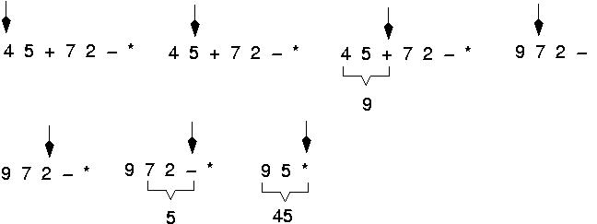
Example: postfix expressions (cont.)

Slide 68
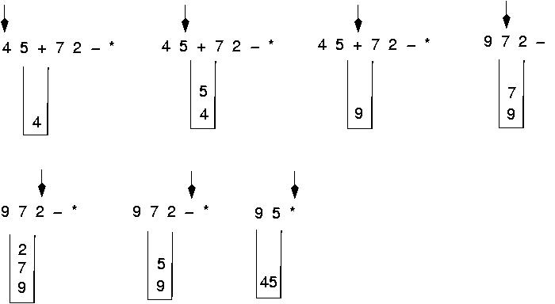
Postfix expressions: Algorithm using stacks (cont.)

Slide 69
Algorithm for evaluating a postfix expression (Cond.)
WHILE more input items exist
{
If symb is an operand
then push (opndstk,symb)
else //symbol is an operator
{
Opnd1=pop(opndstk);
Opnd2=pop(opndnstk);
Value = result of applying symb to opnd1 & opnd2
Push(opndstk,value);
} //End of else
} // end while
Result = pop (opndstk);

Slide 70
Question : Evaluate the following expression in postfix : 623+-382/+*2^3+
Final answer is
49
51
52
7
None of these

Slide 71
Parsing Reverse-Polish Notation
The easiest way to parse reverse-Polish notation is to use an operand stack:
operands are processed by pushing them onto the stack
when processing an operator:
pop the last two items off the operand stack,
perform the operation, and
push the result back onto the stack

Slide 72
Reverse-Polish Notation
Evaluate the following reverse-Polish expression using a stack:
1 2 3 + 4 5 6 × – 7 × + – 8 9 × +

Slide 73
Reverse-Polish Notation
Push 1 onto the stack
1 2 3 + 4 5 6 × – 7 × + – 8 9 × +
1

Slide 74
Reverse-Polish Notation
Push 1 onto the stack
1 2 3 + 4 5 6 × – 7 × + – 8 9 × +
2
1

Slide 75
Reverse-Polish Notation
Push 3 onto the stack
1 2 3 + 4 5 6 × – 7 × + – 8 9 × +
3
2
1

Slide 76
Reverse-Polish Notation
Pop 3 and 2 and push 2 + 3 = 5
1 2 3 + 4 5 6 × – 7 × + – 8 9 × +
5
1

Slide 77
Reverse-Polish Notation
Push 4 onto the stack
1 2 3 + 4 5 6 × – 7 × + – 8 9 × +
4
5
1

Slide 78
Reverse-Polish Notation
Push 5 onto the stack
1 2 3 + 4 5 6 × – 7 × + – 8 9 × +
5
4
5
1

Slide 79
Reverse-Polish Notation
Push 6 onto the stack
1 2 3 + 4 5 6 × – 7 × + – 8 9 × +
6
5
4
5
1

Slide 80
Reverse-Polish Notation
Pop 6 and 5 and push 5 × 6 = 30
1 2 3 + 4 5 6 × – 7 × + – 8 9 × +
30
4
5
1

Slide 81
Reverse-Polish Notation
Pop 30 and 4 and push 4 – 30 = –26
1 2 3 + 4 5 6 × – 7 × + – 8 9 × +
–26
5
1

Slide 82
Reverse-Polish Notation
Push 7 onto the stack
1 2 3 + 4 5 6 × – 7 × + – 8 9 × +
7
–26
5
1

Slide 83
Reverse-Polish Notation
Pop 7 and –26 and push –26 × 7 = –182
1 2 3 + 4 5 6 × – 7 × + – 8 9 × +
–182
5
1

Slide 84
Reverse-Polish Notation
Pop –182 and 5 and push –182 + 5 = –177
1 2 3 + 4 5 6 × – 7 × + – 8 9 × +
–177
1

Slide 85
Reverse-Polish Notation
Pop –177 and 1 and push 1 – (–177) = 178
1 2 3 + 4 5 6 × – 7 × + – 8 9 × +
178

Slide 86
Reverse-Polish Notation
Push 8 onto the stack
1 2 3 + 4 5 6 × – 7 × + – 8 9 × +
8
178

Slide 87
Reverse-Polish Notation
Push 1 onto the stack
1 2 3 + 4 5 6 × – 7 × + – 8 9 × +
9
8
178

Slide 88
Reverse-Polish Notation
Pop 9 and 8 and push 8 × 9 = 72
1 2 3 + 4 5 6 × – 7 × + – 8 9 × +
72
178

Slide 89
Reverse-Polish Notation
Pop 72 and 178 and push 178 + 72 = 250
1 2 3 + 4 5 6 × – 7 × + – 8 9 × +
250

